Slide 1
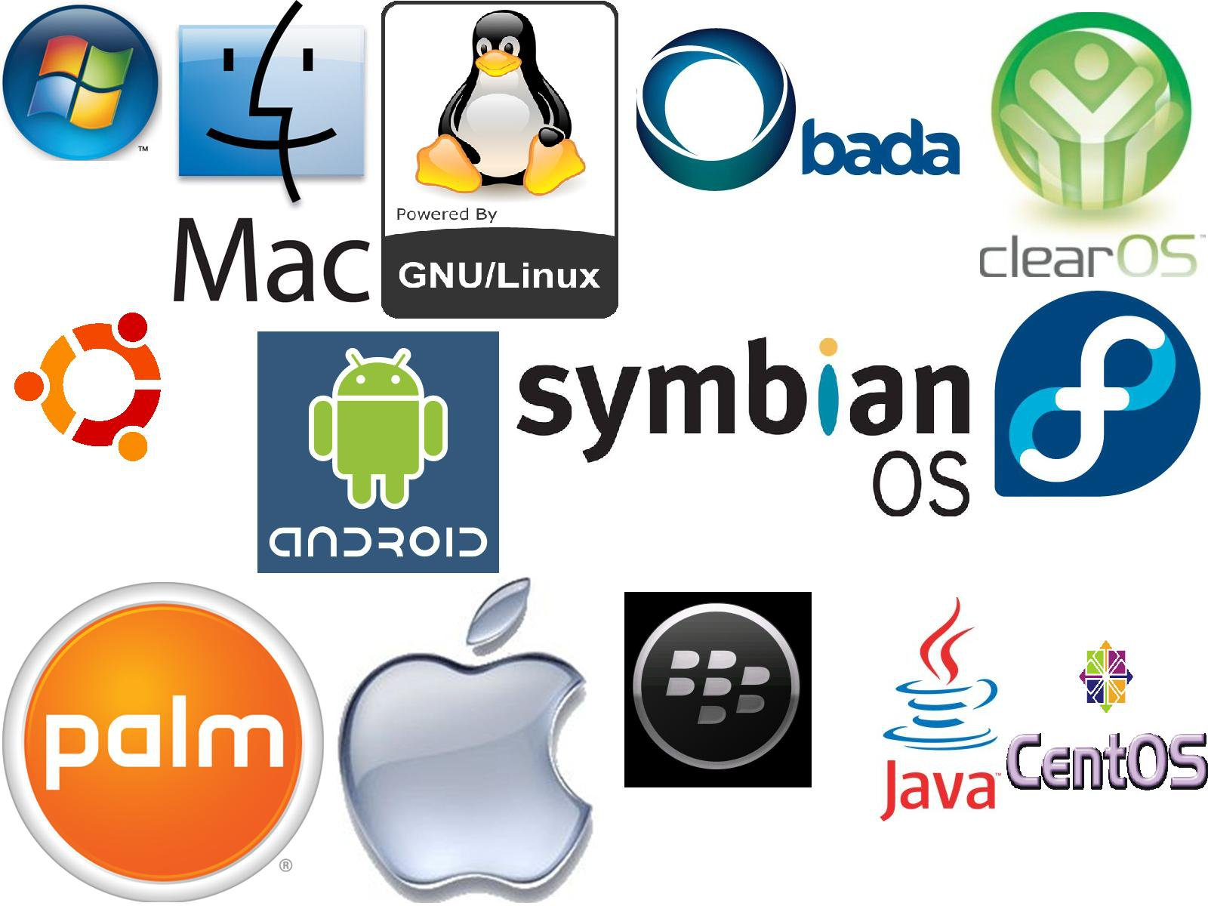
OPERATING SYSTEM
Er. Deeyoranjan Dongol

Slide 2
Software that controls the hardware
A program that makes the hardware usable
OS
An interface between the application program and the hardware level
System software that acts as mediator between the user and computer

Slide 3
OBJECTIVES OF OS
Hide details of hardware by creating abstraction
Allocate resources to processes
Provide a pleasant and effective user interface
Main objectives of an OS:
Convenience
Efficiency
Ability to evolve

Slide 4
REASONS FOR EVOLUTION OF OS
Hardware upgrades
New types of hardware
New services
Fixes

Slide 5
User View
Two Views of OS
System View
As Resource Manager

Slide 6
Personal computer- make interaction easy and attention on performance of system
System is connected to a main frame computer- resource utilization
User View
Workstation connected to other workstation- individual usage of resources and sharing
Handheld computer- usability of the device and battery level
Notes:
User View
The user view depends on the system interface that is used by the users. The different types of user view experiences can be explained as follows:
If the user is using a personal computer, the operating system is largely designed to make the interaction easy. Some attention is also paid to the performance of the system, but there is no need for the operating system to worry about resource utilization. This is because the personal computer uses all the resources available and there is no sharing.
If the user is using a system connected to a mainframe or a minicomputer, the operating system is largely concerned with resource utilization. This is because there may be multiple terminals connected to the mainframe and the operating system makes sure that all the resources such as CPU,memory, I/O devices etc. are divided uniformly between them.
If the user is sitting on a workstation connected to other workstations through networks, then the operating system needs to focus on both individual usage of resources and sharing though the network. This happens because the workstation exclusively uses its own resources but it also needs to share files etc. with other workstations across the network.
If the user is using a handheld computer such as a mobile, then the operating system handles the usability of the device including a few remote operations. The battery level of the device is also taken into account.
System View
According to the computer system, the operating system is the bridge between applications and hardware. It is most intimate with the hardware and is used to control it as required.
The different types of system view for operating system can be explained as follows:
The system views the operating system as a resource allocator. There are many resources such as CPU time, memory space, file storage space, I/O devices etc. that are required by processes for execution. It is the duty of the operating system to allocate these resources judiciously to the processes so that the computer system can run as smoothly as possible.
The operating system can also work as a control program. It manages all the processes and I/O devices so that the computer system works smoothly and there are no errors. It makes sure that the I/O devices work in a proper manner without creating problems.
Operating systems can also be viewed as a way to make using hardware easier.
Computers were required to easily solve user problems. However it is not easy to work directly with the computer hardware. So, operating systems were developed to easily communicate with the hardware.
An operating system can also be considered as a program running at all times in the background of a computer system (known as the kernel) and handling all the application programs. This is the definition of the operating system that is generally followed.

Slide 7
Resource Allocator
Control Program
System View
Easily Communicate with hardware
Handling all applications programs

Slide 8
As Virtual Machine
Role of OS
As Resource Manager
As Resource Manager

Slide 9
TYPES OF OPERATING SYSTEM
Batch System
Uniprogramming
Multiprogramming
Time Sharing
Real Time
Mainframe operating system
Personal computer operating system
Smart card operating system

Slide 10
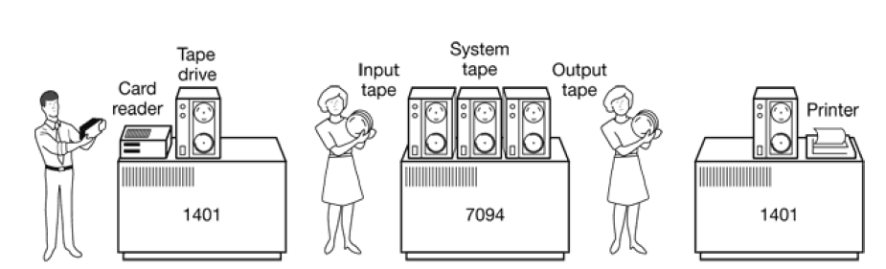
SIMPLE BATCH SYSTEMS

Slide 11

UNIPROGRAMMING
The processor spends a certain amount of time executing, until it reaches an I/O instruction; it must then wait until that I/O instruction concludes before proceeding

Slide 12
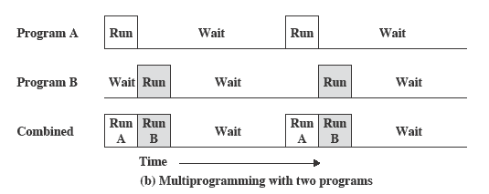
MULTIPROGRAMMING
There must be enough memory to hold the OS and one user program
When one job needs to wait for I/O, the processor can switch to the other job, which is likely not waiting for I/O

Slide 13
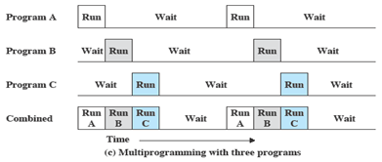
MULTIPROGRAMMING
also known as multitasking
memory is expanded to hold three, four, or more programs and switch among all of them

Slide 14
TIME SHARING SYSTEMS
Can be used to handle multiple interactive jobs
Processor time is shared among multiple users
Multiple users simultaneously access the system through terminals, with the OS interleaving the execution of each user program in a short burst or quantum of computation

Slide 15
REAL TIME OPERATING SYSTEM
Real Time Operating System
Hard Operating System
Action must occur at certain moment
Hard deadline
Soft Operating System
-Missing an occasional deadline is acceptable
- Soft deadline

Slide 16
MAINFRAME OPERATING SYSTEM
Oriented towards processing many jobs at once
Offer services such as batch, transaction processing and timesharing
Example OS/390

Slide 17
PERSONAL COMPUTER OPERATING SYSTEM
Their job is to provide a good interface to a single user
They are widely used for word processing, spreadsheets, and Internet access
Examples are Windows 98, Windows 2000, the Macintosh operating system, and Linux

Slide 18
SMART CARD OPERATING SYSTEM
Run on smart cards which are credit card-sized devices containing a CPU chip
Posses severe processing power and memory
Can handle single or multiple functions
Resource management and protection issues must be handled by the OS present on the card

Slide 19
OPERATING SYSTEM STRUCTURE
Monolithic Systems
Layered Systems
Virtual Machines
Micro Kernel /Client-Server Model

Slide 20
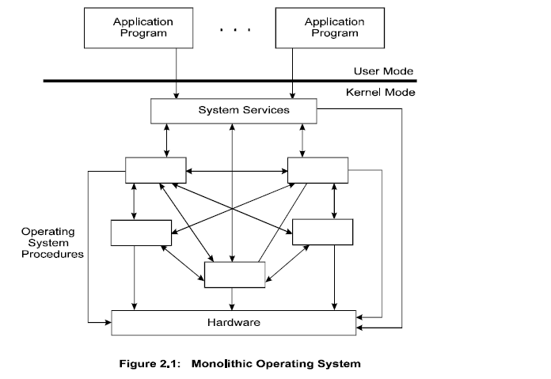
MONOLITHIC SYSTEMS
Notes:
Like other OS → kernel mode and user mode
Operating system code runs in kernel mode with access to system data and hardware
applications run in user mode with limited set of interfaces and with limited access to system data
operating system is written as collection of procedures
components are organized haphazardly [BIG MESS]
any module can call another module without any reservation
each procedure in the system has well defined interface (parameters and results) and free to call other if the latter provides
useful computation that the former needs [example :- MSDOS]

Slide 21
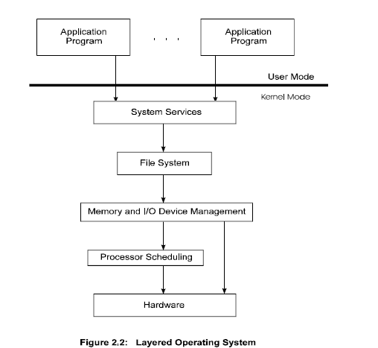
LAYERED SYSTEMS
Notes:
consists of breaking the OS into numerous layers
bottom layer ( layer 0) → Hardware
highest layer → user interface
modularity→ layers are selected such that each uses functions and services of only lower level [ debugging + system verification]
Nth layer can access services provided by (N-1)th layer and provide services to (N+1)th layer
One entire layer can be replaced without affecting the other parts of system
Example:- UNIX

Slide 22
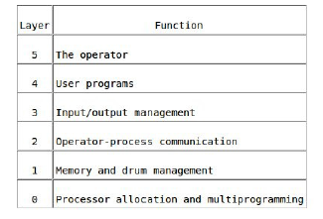
THE OPERATING SYSTEM
Notes:
The system had 6 layers,
Layer 0 dealt with allocation of the processor, switching between processes when interrupts occurred or timers expired.
Layer 0 provided the basic multiprogramming of the CPU.
Layer 1 did the memory management. It allocated space for processes in main memory and on a 512K word drum used for holding parts of processes
(pages) for which there was no room in main memory.
Layer 1 software took care of making sure pages were brought into memory whenever they were needed.
Layer 2 handled communication between each process and the operator console. Above this layer each process effectively had its own operator
console.
Layer 3 took care of managing the I/O devices and buffering the information streams to and from them.
Layer 4 was where the user programs were found.
The system operator process was located in layer 5.

Slide 23
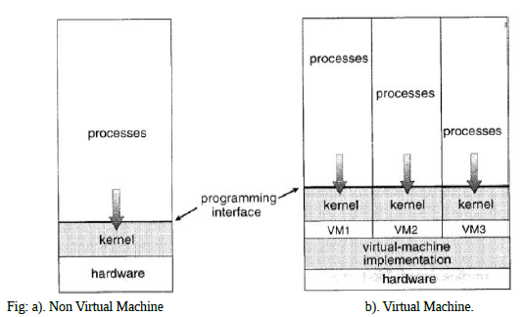
VIRTUAL MACHINES
Notes:
interface
the resources of physical computer are shared to create the VM
CPU scheduling time can be used to share the CPU
appears like users have their own processors Example:- JAVA

Slide 24
VIRTUALIZATION
Enables a single PC or server to simultaneously run multiple operating systems or multiple sessions of a single OS
A machine can host numerous applications, including those that run on different operating systems, on a single platform
Host operating system can support a number of virtual machines (VM)
Each has the characteristics of a particular OS and, in some versions of virtualization, the characteristics of a particular hardware platform
Notes:
Traditionally, applications have run directly on an OS on a PC or a server. Each PC
or server would run only one OS at a time. Thus, the vendor had to rewrite parts
of its applications for each OS/platform they would run on. An effective strategy
for dealing with this problem is known as virtualization . Virtualization technology
enables a single PC or server to simultaneously run multiple operating systems or
multiple sessions of a single OS. A machine with virtualization can host numerous
applications, including those that run on different operating systems, on a single
platform. In essence, the host operating system can support a number of virtual
machines (VM) , each of which has the characteristics of a particular OS and, in some
versions of virtualization, the characteristics of a particular hardware platform.
The VM approach is becoming a common way for businesses and individuals
to deal with legacy applications and to optimize their hardware usage by maximizing
the number of kinds of applications that a single computer can handle [GEER09].
Commercial VM offerings by companies such as VMware and Microsoft are widely
used, with millions of copies having been sold. In addition to their use in server
environments, these VM technologies also are used in desktop environments to run
multiple operating systems, typically Windows and Linux.

Slide 25
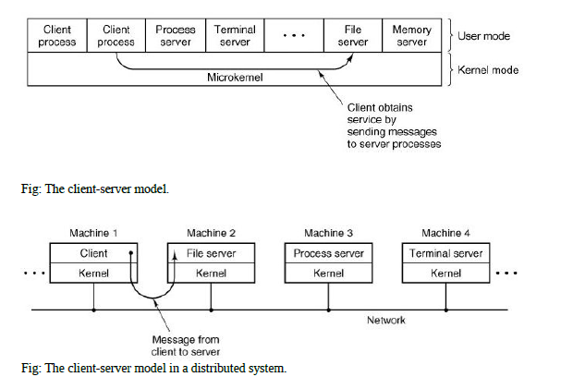
CLIENT SERVER MODEL / MICROKERNEL
Notes:
Each server runs in user mode and provides services to requested client
Client → requests a service→ sends message to server
microkernel running in kernel mode delivers the message to appropriate server
the server performs the operation and microkernel delivers the result to the client in another message

Slide 26
THE SHELL
UNIX command interpreter
Not a part of operating system but makes heavy use of many operating system features and serves as a good example of how the system calls can be used
Primary interface between a user and operating system
Has terminal as standard input and standard output
Starts out by typing the prompt which tells the user that the shell is waiting to accept a command
Examples: sh, csh, ksh, bash
date
The shell creates a child process and runs the date program as the child. While the child process is running, the shell waits for it to terminate. When the child finishes, the shell types the prompt again and tries to read the next input line.

Slide 27
OPEN SOURCE OPERATING SYSTEM
Open source is a methodology or approach towards the design and development of software with the intention of giving the user to access the source
Using open source software allows us to see how it works, debug it, modify it and redistribute it
Licensed in way that makes it legal to use as many copies of it wherever wanted
Open source allows commercial utilization of code with the motive of profits
Examples: Linux, Minix, Free BSD, Open BSD, Open Solaris

Slide 28
SYSTEM CALL
The mechanism used by an application program to request service from the operating system
Performed in series of steps
Use a special machine code instruction which causes the processor to change mode (e.g. to "supervisor mode" or "protected mode")
Allows the OS to perform restricted actions such as accessing hardware devices or the memory management unit

Slide 29
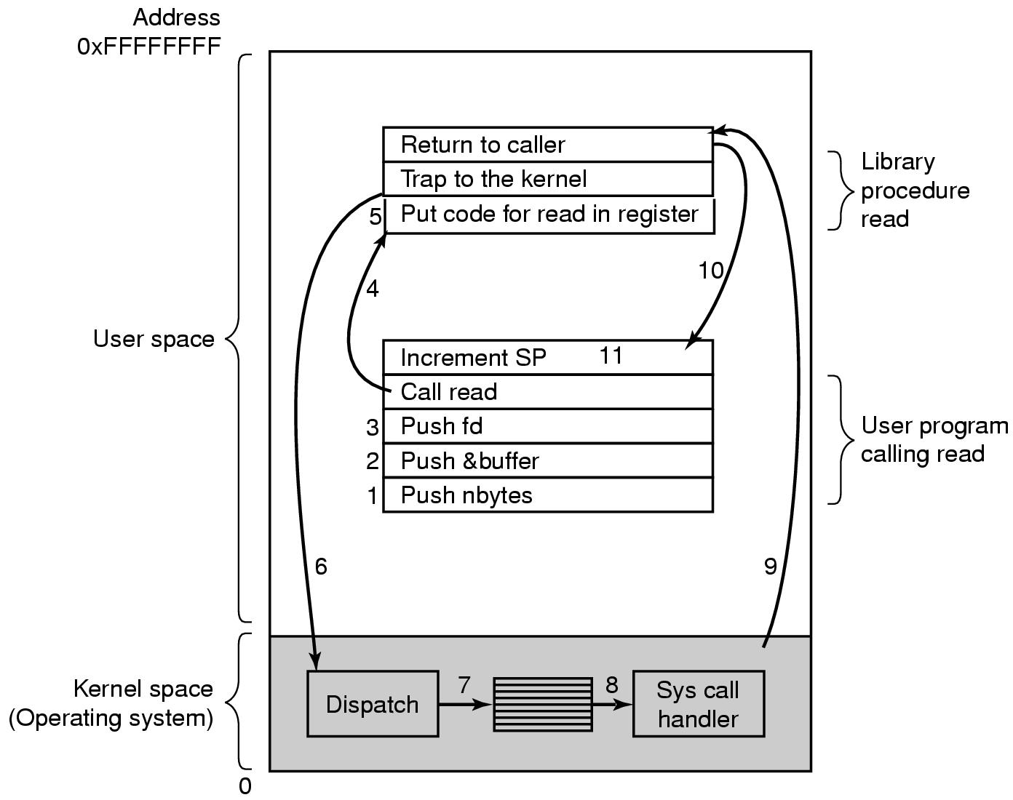
SYSTEM CALL STEPS
There are 11 steps in making the system call
read (fd, &buffer, nbytes)
Notes:
1-3) Calling program pushes parameters onto the stack
4) Actual call to library procedure
5) Library procedure puts the system call number in register
6) Executes TRAP instruction to switch from user mode to kernel mode
7) Kernel mode examines the system call number and then dispatches to correct system call handler →table of pointers to system call handlers indexed on system call number
8) System call handler runs
9) After it completes its works, control returns to user-space library procedure at the instruction following the TRAP instruction
10) Then control returns to user program
11) User program clean up the stack

Slide 30
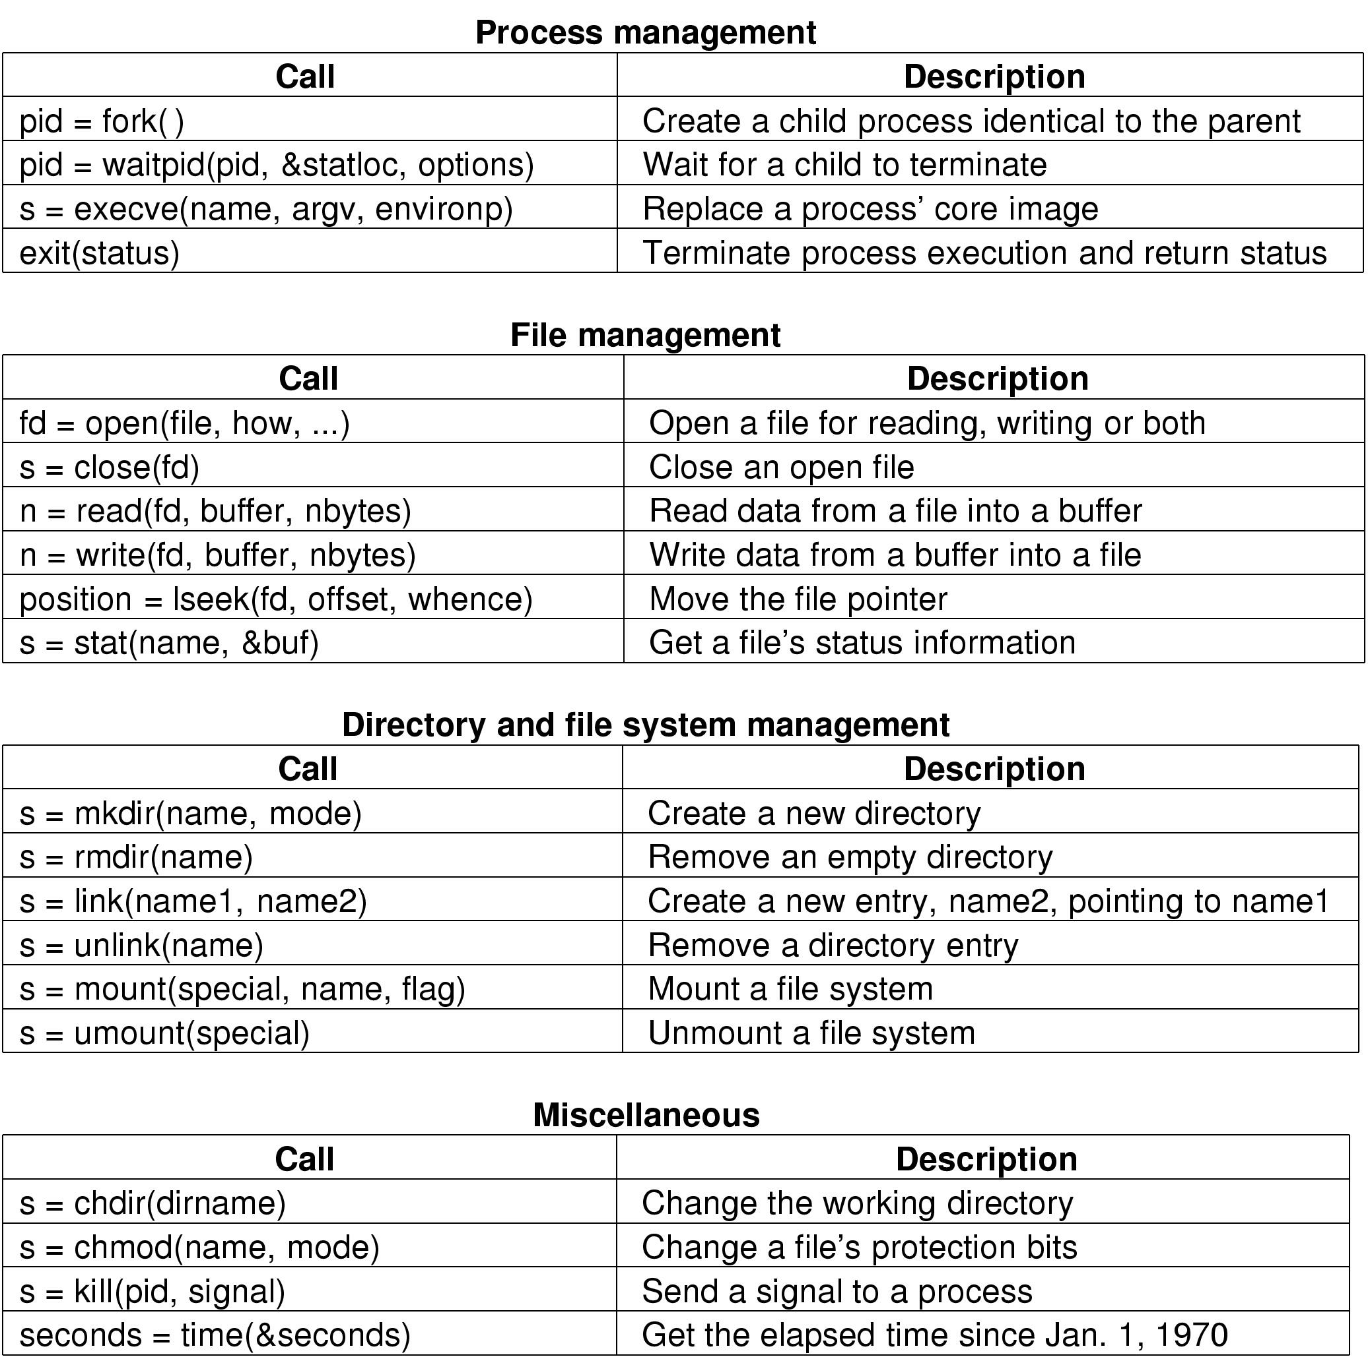
SYSTEM CALL FOR PROCESS MANAGEMENT

Slide 31
SYSTEM CALL FOR FILE MANAGEMENT

Slide 32
SYSTEM CALL FOR DIRECTORY AND FILE SYSTEM MANAGEMENT

Slide 33
SYSTEM CALL FOR MISCELLANEOUS TASK

Slide 34
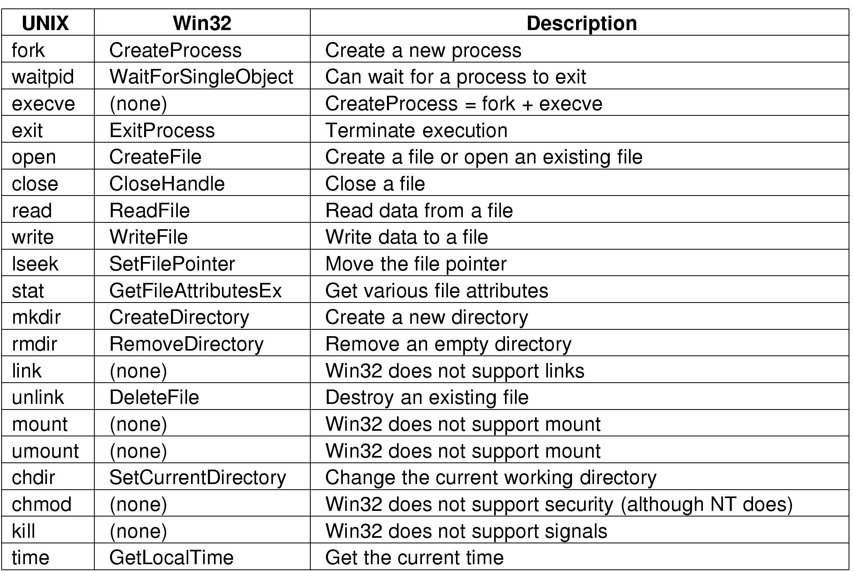
SOME WIN32 API CALLS

